Slide 1
Local Structure-Preserving
Bridge for Long-Document RAG
By: Naman Saboo
April 2026
Notes:
Hi everyone, I’m presenting my final project on local structure-preserving bridge methods for long-document RAG.
The starting idea was that long documents make retrieval harder because related evidence gets split across nearby chunks. So, I wanted to test whether a lightweight local bridge expansion could recover some of that context without needing a much more complicated graph-based system.
What ended up being most interesting is that, once I cleaned up the evaluation, the final answer was not what I originally expected.

Slide 2
02
Problem & Motivation
The Core Problem
Original Hypothesis
Standard RAG treats chunks as independent retrieval units
In long documents, local structure breaks and nearby related evidence gets separated
This hurts retrieval on multi-part, non-local questions
A local bridge that reattaches nearby context could close the gap without full graph retrieval.
Benchmark: QASPER — multi-evidence questions over scientific papers
Notes:
The core issue is that standard RAG usually treats chunks as independent retrieval units. That’s often fine for short documents, but in long scientific papers, evidence that belongs together can get separated across nearby chunks.
That matters a lot for questions that need multiple pieces of evidence or evidence that is not all in one place.
So the original hypothesis was that a local bridge expansion could help reconnect that nearby context. I used QASPER as the main development dataset, because it’s built around questions over scientific papers and a lot of those questions require multi-passage evidence.

Slide 3
03
What Changed from the Proposal
Originally Planned
What Actually Happened
QASPER + FinanceBench datasets
Fixed-size, paragraph, adjacency, and bridge chunk comparisons
Retrieval + answer-level evaluation
Bridge expected to outperform flat retrieval
QASPER only; FinanceBench not completed
Major evaluation protocol cleanup
Answer eval remained secondary signal
Flat hybrid retrieval won - bridge did not outperform
The methodology became more defensible, even as the headline result changed.
Notes:
This project changed a lot from the original proposal.
Originally, I planned to do QASPER and FinanceBench, compare several chunking and bridge variants, and I expected bridge retrieval to outperform flat retrieval.
What actually happened is that the evaluation side became much more important than I expected. I ended up doing a major protocol reset, and once I did that, the story changed. FinanceBench was not completed, answer evaluation stayed secondary, and the final winner became flat hybrid retrieval rather than bridge.
So the result is less exciting in one sense, but much more defensible scientifically.

Slide 4
04
Protocol Reset
1
Split Hygiene
2
Hard Subsets
3
Retrieval Metrics
Validation for selection, test reserved for final reporting
Method-independent hard subsets (skip_local, multi_span, float_table) isolate specific failure modes
Evidence hit and coverage as primary metrics; EM/F1 secondary
Every result in this talk uses the cleaned protocol
Notes:
This was the most important methodological step in the whole project.
I separated validation from test, so model selection happened on validation only and test was kept for final reporting. I also introduced harder method-independent subsets like skip_local, multi_span, and float_table, and I changed the main retrieval metrics to evidence hit and evidence coverage.
That mattered because these metrics directly measure whether the retriever found the gold supporting evidence, which is really the core issue here.
So this is the point where the project became much more trustworthy than the earlier exploratory version.

Slide 5
05
Method Ladder
Core retrieval comparisons
Supporting studies
Flat hybrid retrieval
Dense + sparse retrieval over paragraph-pair chunks, no expansion
Bridge family
Local expansion on retrieved seeds
Fixed chunk control
Deterministic fixed-size chunk baseline
Structure-aware representation
Captions, float-like units, inline references
Answer evaluation
Local QA reader used as a secondary downstream signal
Model selection focused on retrieval methods; supporting studies informed interpretation but did not become the final winner.
Notes:
After the protocol reset, the main comparison was between a strong flat hybrid retriever, the bridge-family methods, and a fixed chunk control.
I also ran two supporting studies. One was a structure-aware representation study, where I added things like captions, float-like units, and inline references. The other was an answer-evaluation layer with a local QA reader.
Those supporting studies were useful for interpretation, but the main model-selection question was still really flat versus bridge.

Slide 6
06
Validation Turning Point
Method | Retrieval Metrics (Primary) |  | Answer Metrics (Secondary)
 | Ev. Hit | Ev. Coverage | EM | F1 | Empty %
Flat Hybrid | 0.8617 | 0.7833 | 0.1682 | 0.2503 | 27.0%
Bridge Final | 0.8438 | 0.7567 | 0.1343 | 0.1659 | 46.3%
Flat hybrid won every validation metric — the turning point for the project.
Notes:
This is the main turning point in the project.
Under the cleaned validation protocol, flat_hybrid_current beat bridge_final_current on the primary retrieval metrics. Flat reached an evidence hit of 0.8617 and evidence coverage of 0.7833, while bridge final reached 0.8438 and 0.7567. So the flat model was ahead by about 0.018 on hit and 0.027 on coverage.
Even the secondary answer metrics moved in the same direction. Flat had validation F1 = 0.2503, compared with 0.1659 for bridge final, and the empty prediction rate was much lower for flat, about 27% versus 46.3% for bridge.
So once the evaluation became cleaner, the best-performing method was no longer bridge, it was flat

Slide 7
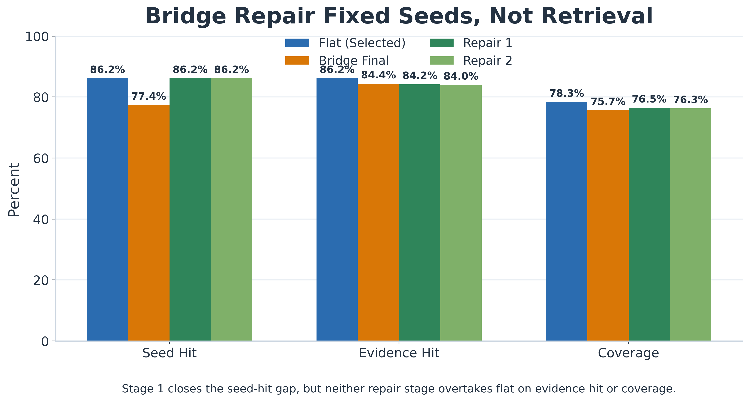
07
Bridge Repair: Testing Fairness
Key question: Was bridge underperforming simply because it started from weaker seed retrieval?
Notes:
At that point, the obvious objection was: maybe bridge only lost because it started from weaker seeds.
And that was actually a real concern, because the original bridge seed hit was only 0.7741, while flat’s seed hit was 0.8617.
So in Bucket 4.5 I tested that directly. I forced bridge to use the exact same flat seed stage. That completely repaired the seed fairness issue, because the repaired bridge variants now had the same seed hit as flat: 0.8617.
But even after doing that, bridge still didn’t beat flat. The repaired always-on bridge got 0.8418 evidence hit and 0.7647 coverage, and the selective version got 0.8398 hit and 0.7627 coverage. So repairing the seeds improved fairness, but it still did not overturn the flat winner.
That’s important because it rules out the easy explanation that bridge only lost because it was handicapped upstream.

Slide 8
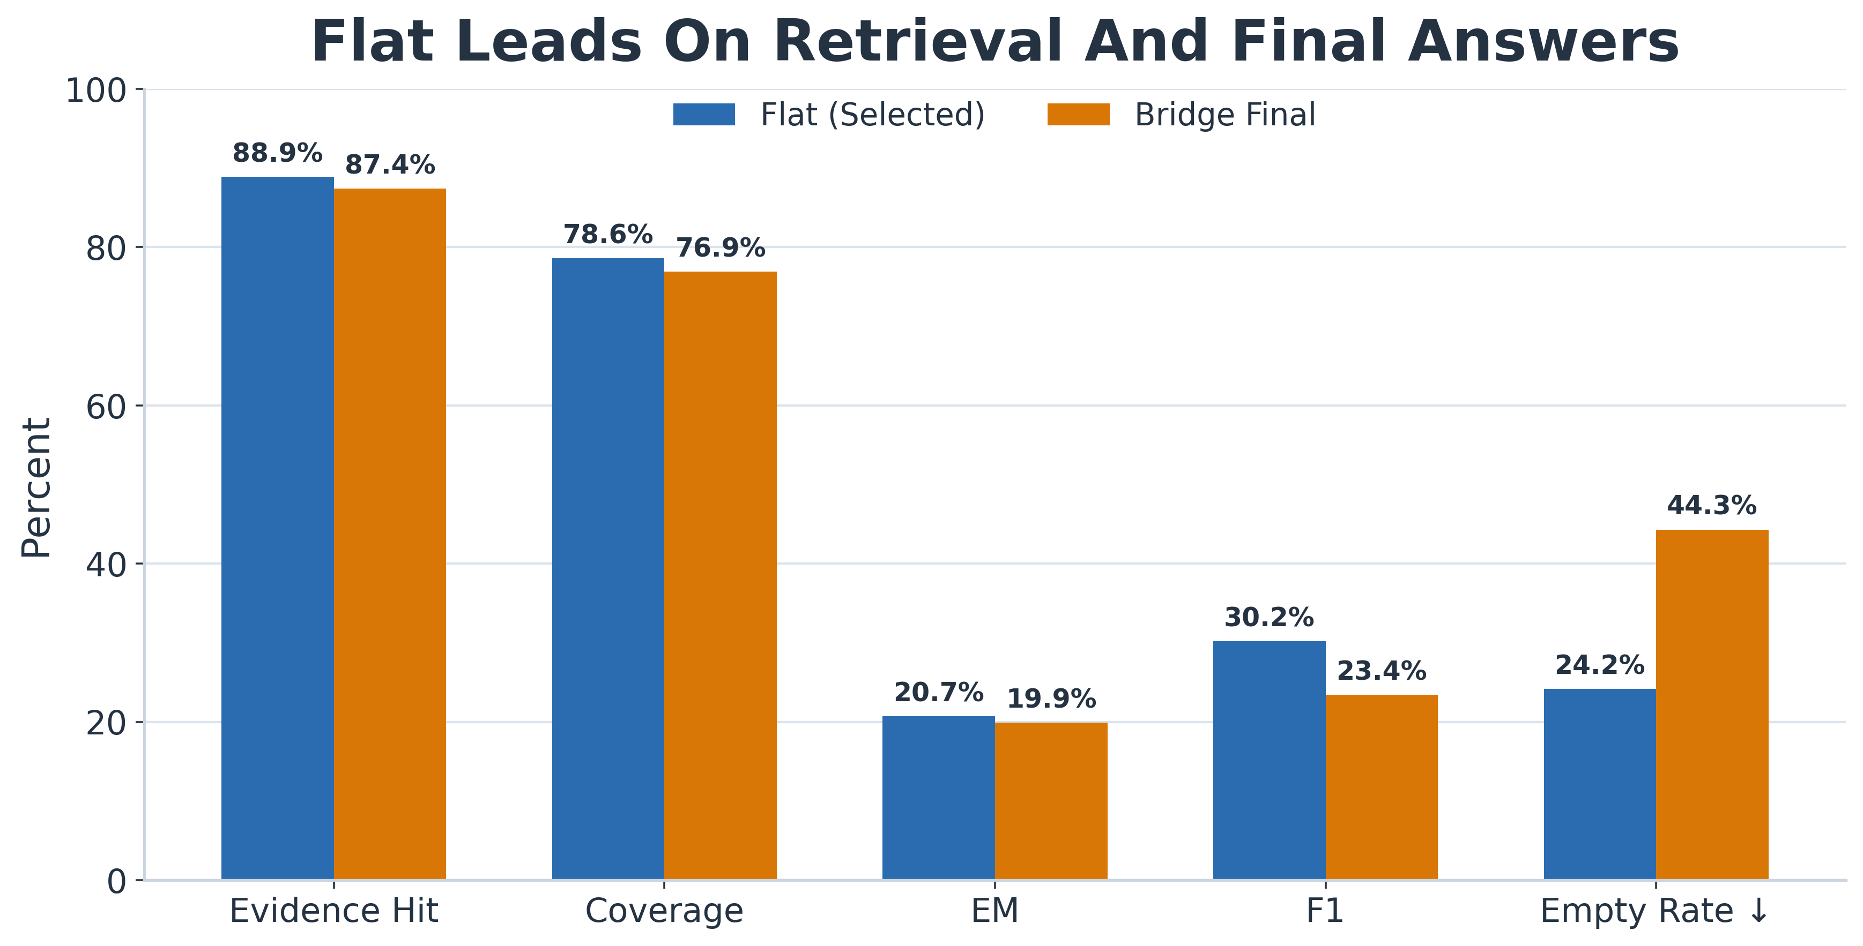
08
Held-Out Test Confirms the Winner
Method | Ev. Hit | Ev. Coverage | F1 | Empty Rate
Flat Hybrid | 0.8890 | 0.7862 | 0.3022 | 24.2%
Bridge Final | 0.8739 | 0.7690 | 0.2343 | 44.3%
Flat hybrid held its validation lead on unseen test data.
Notes:
After that, I locked the final model and ran the held-out test comparison.
The same conclusion held on test. flat_hybrid_current reached 0.8890 evidence hit and 0.7862 evidence coverage, while bridge_final_current reached 0.8739 and 0.7690. So flat still stayed ahead on the primary retrieval story.
The secondary answer metrics also supported that direction. On test, flat had EM = 0.2074 and F1 = 0.3022, while bridge had EM = 0.1992 and F1 = 0.2343. The empty prediction rate also stayed much lower for flat: 0.2419 versus 0.4431.
So the validation winner stayed the winner on held-out test.

Slide 9
09
Hard Cases and Remaining Limitations
Hard-Subset Results
Remaining Limitations
Subset | Flat Hit | Bridge Hit
skip_local | 0.9904 | 0.9840
multi_span | 0.9891 | 0.9891
float_table | 0.9443 | 0.9319
Local QA reader remained imperfect, so answer metrics stayed secondary
Structure-aware representation helped some hard cases, but did not become the default
Float/table retrieval remains difficult
FinanceBench was not completed
Subset | Flat F1 | Bridge F1
skip_local | 0.3013 | 0.2261
multi_span | 0.2971 | 0.2248
float_table | 0.2764 | 0.1903
Notes:
I also wanted to check where the model was still struggling.
On the hardest subsets, flat was still generally stronger than bridge. On skip_local, flat had 0.9904 retrieval hit and 0.3013 answer F1, compared with 0.9840 and 0.2261 for bridge. On multi_span, both methods had the same retrieval hit of 0.9891, but flat still had a much higher F1: 0.2971 versus 0.2248. And on float_table, flat had 0.9443 retrieval hit and 0.2764 F1, while bridge had 0.9319 and 0.1903.
At the same time, this is also where I’d be honest about the limitations. The local QA reader was still imperfect, so answer metrics stayed secondary. Structure-aware representation helped some hard cases, but it didn’t become the default winner. Float and table retrieval are still difficult. And FinanceBench was not completed.

Slide 10
Takeaways & Questions
1
A cleaner evaluation protocol changed the conclusion: flat hybrid, not bridge, was the best final model.
2
Bridge fairness mattered, but fixing the seed-stage disadvantage still did not overturn the result.
3
The main remaining weaknesses were nonlocal, multi-span, and float/table-heavy questions.
4
Structure-aware representations were useful, but not enough to become the final mainline.
Questions?
Notes:
So the main takeaway is that cleaning up the evaluation protocol actually changed the conclusion.
I started with a bridge-expansion hypothesis, but once the setup became more rigorous, the best-performing method in this project was a flat hybrid retriever.
The bridge-repair study was still very valuable, because it showed that weak bridge seeds were a real fairness issue, but also showed that fixing that issue still did not make bridge the winner.
And the remaining weaknesses are mostly around partial evidence recovery, multi-span and float-table cases, and the answer layer itself.

